Slide 1

CSCI 1102 Computer Science 2
Meeting 15: Tuesday 3/23/2021
Order & Equality

Slide 2
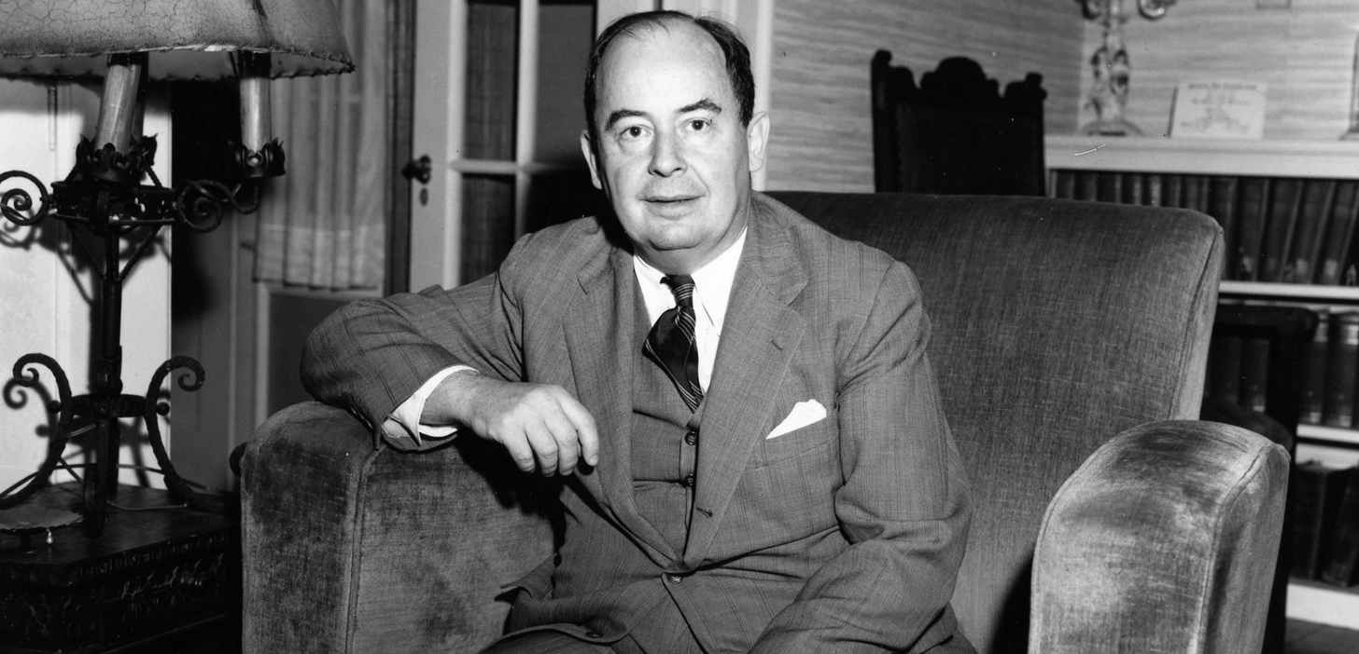
John von Neumann

Slide 3
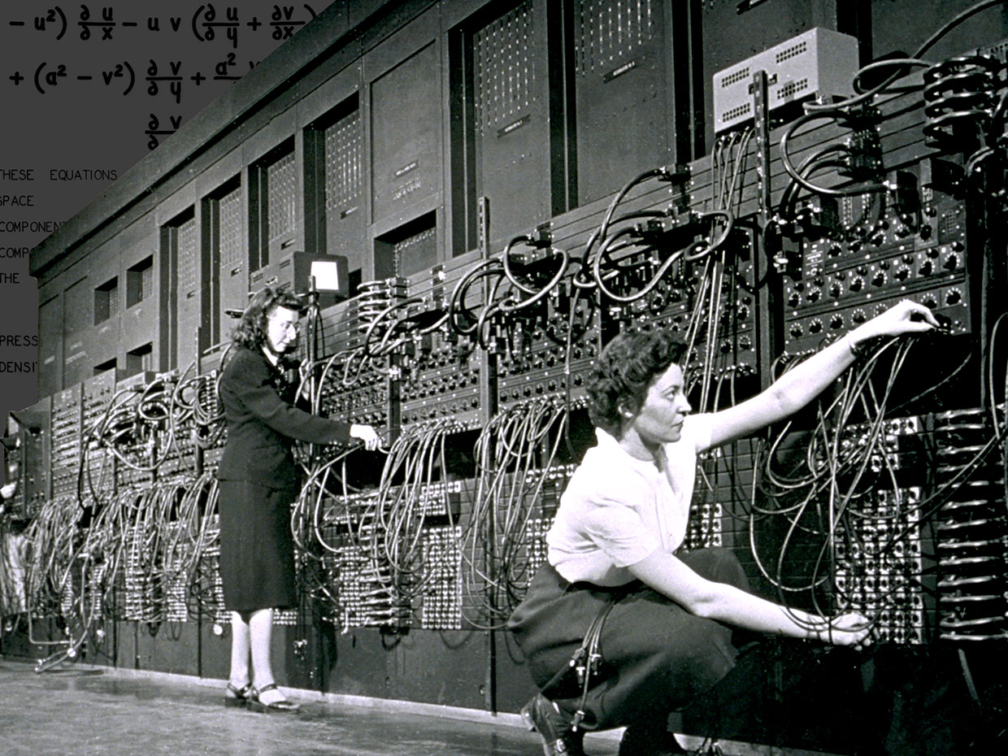

Slide 4
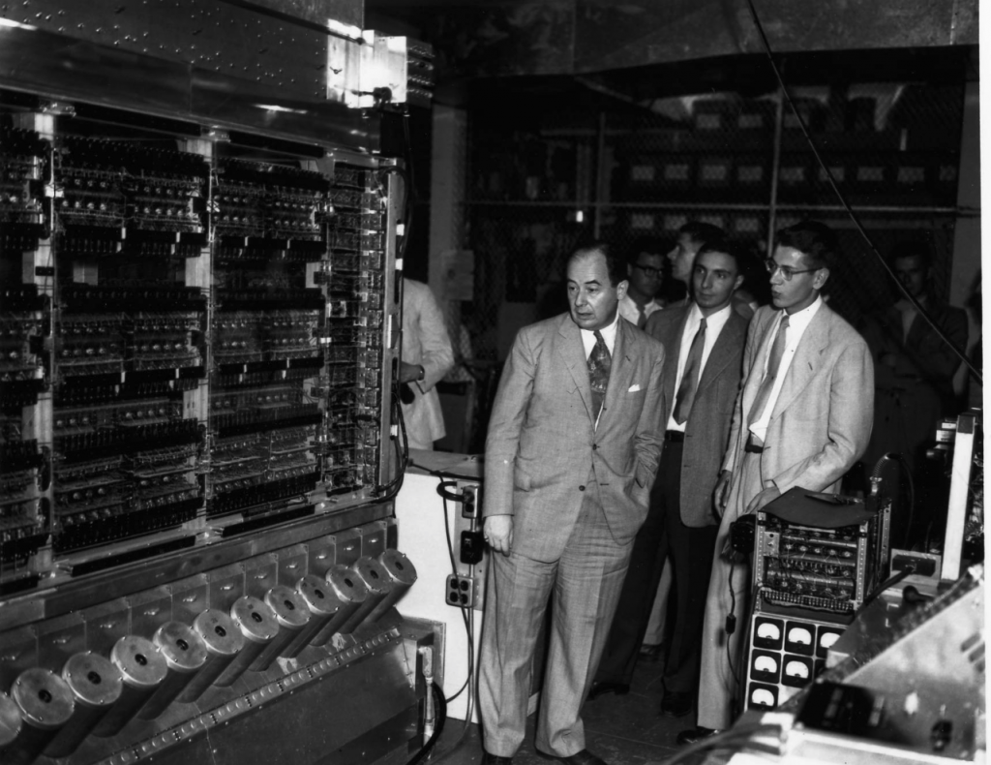

Slide 5
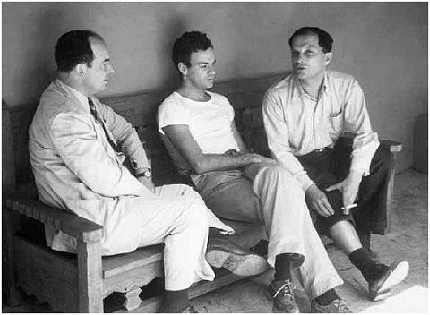
Von Neumann w Richard Feynman & Stanislaw Ulam in Los Alamos

Slide 6
Order & Equality
The Natural Order

Slide 7
equals
compareTo
==
hashCode
compare
<=
null
mutation
new Comparator()

Slide 8
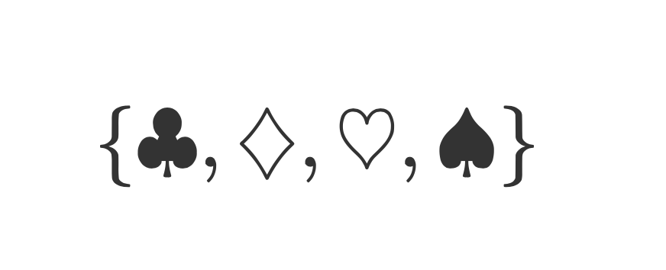
Sets

Slide 9
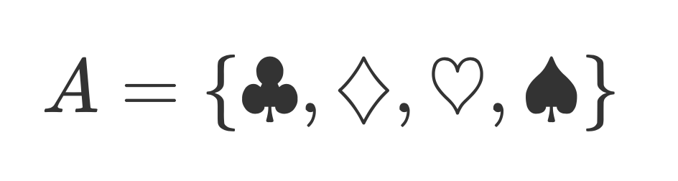
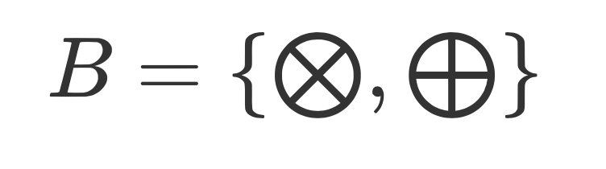
Sets

Slide 10
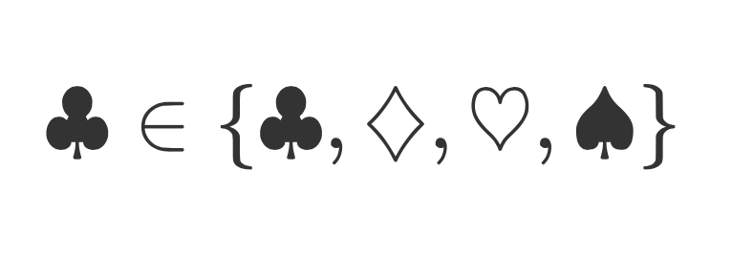
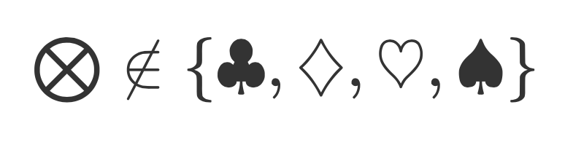
Statements about Containment

Slide 11
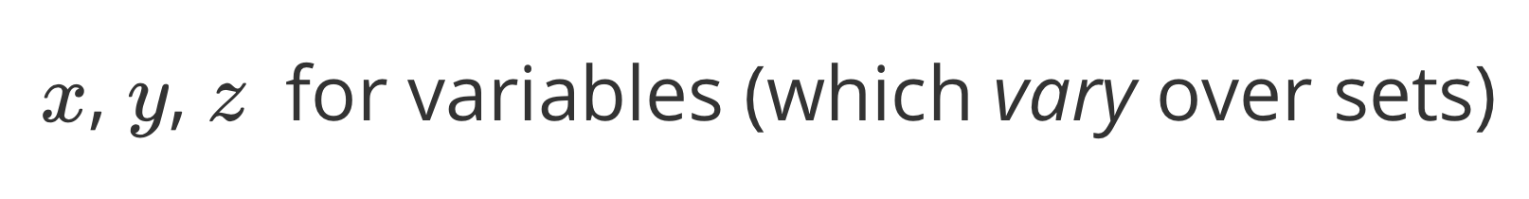
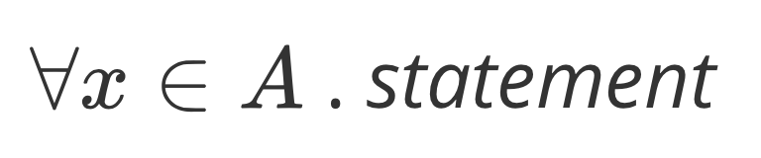
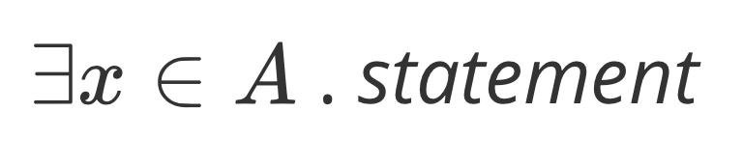
General Statements Variables and their Quantifiers

Slide 12
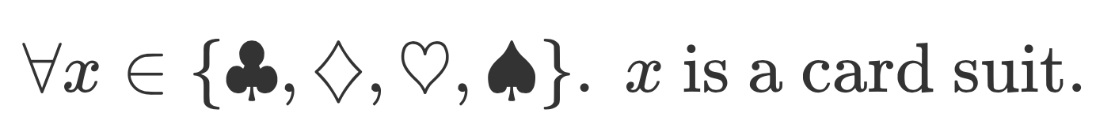
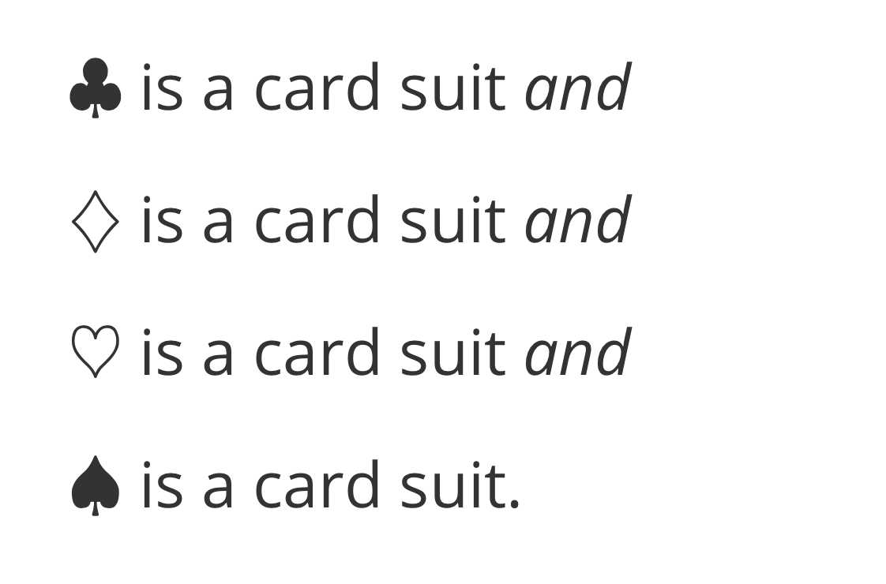

Slide 13
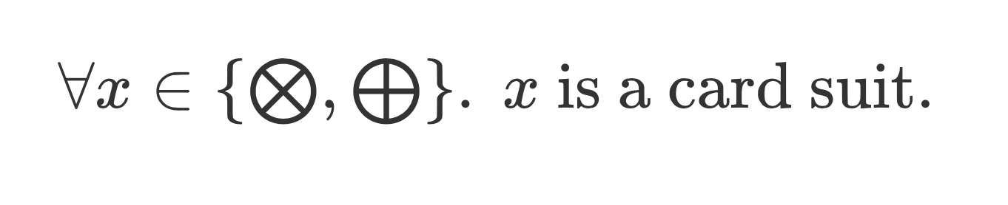
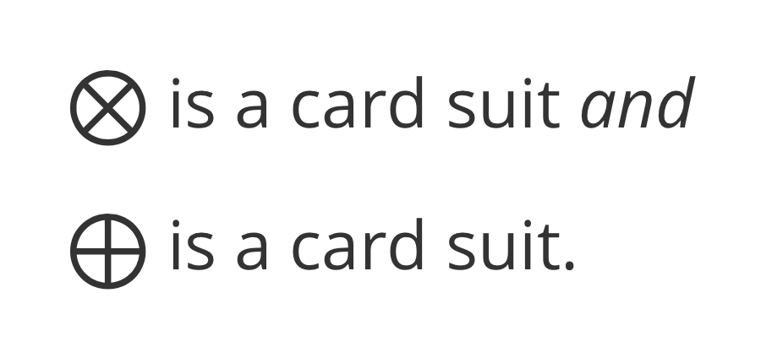
Statements can be true or false.

Slide 14
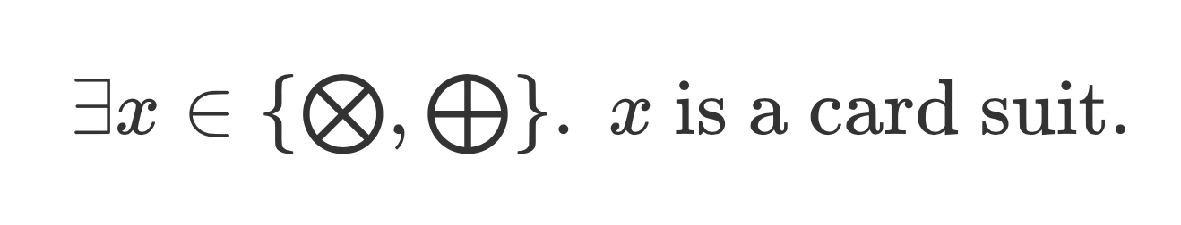
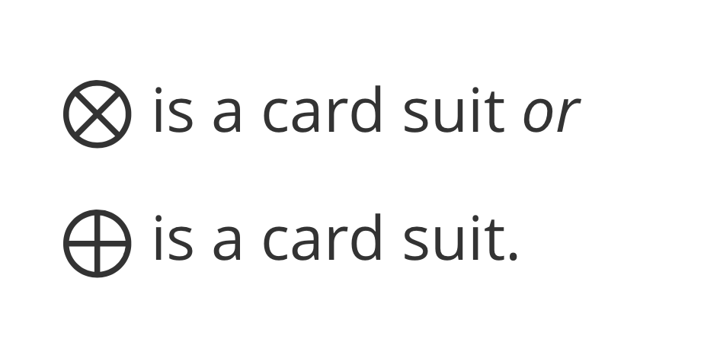
Statements can be true or false.

Slide 15
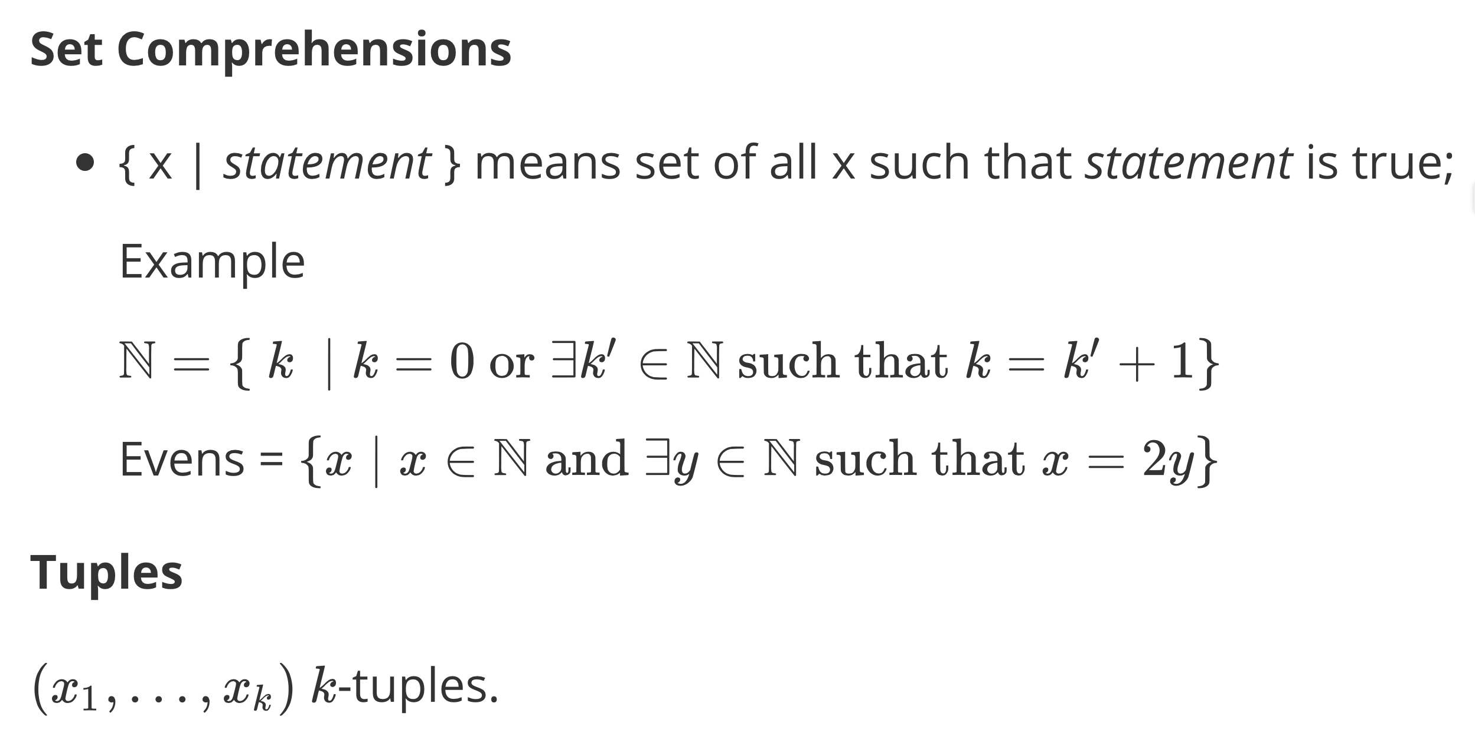

Slide 16
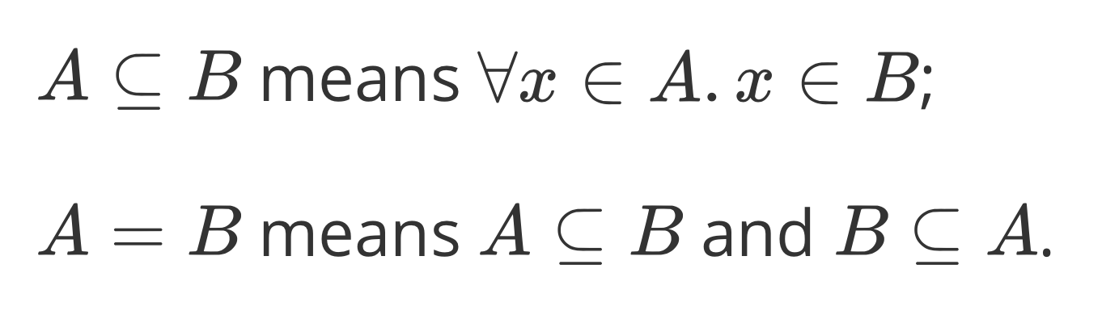
Subset & Set Equality

Slide 17
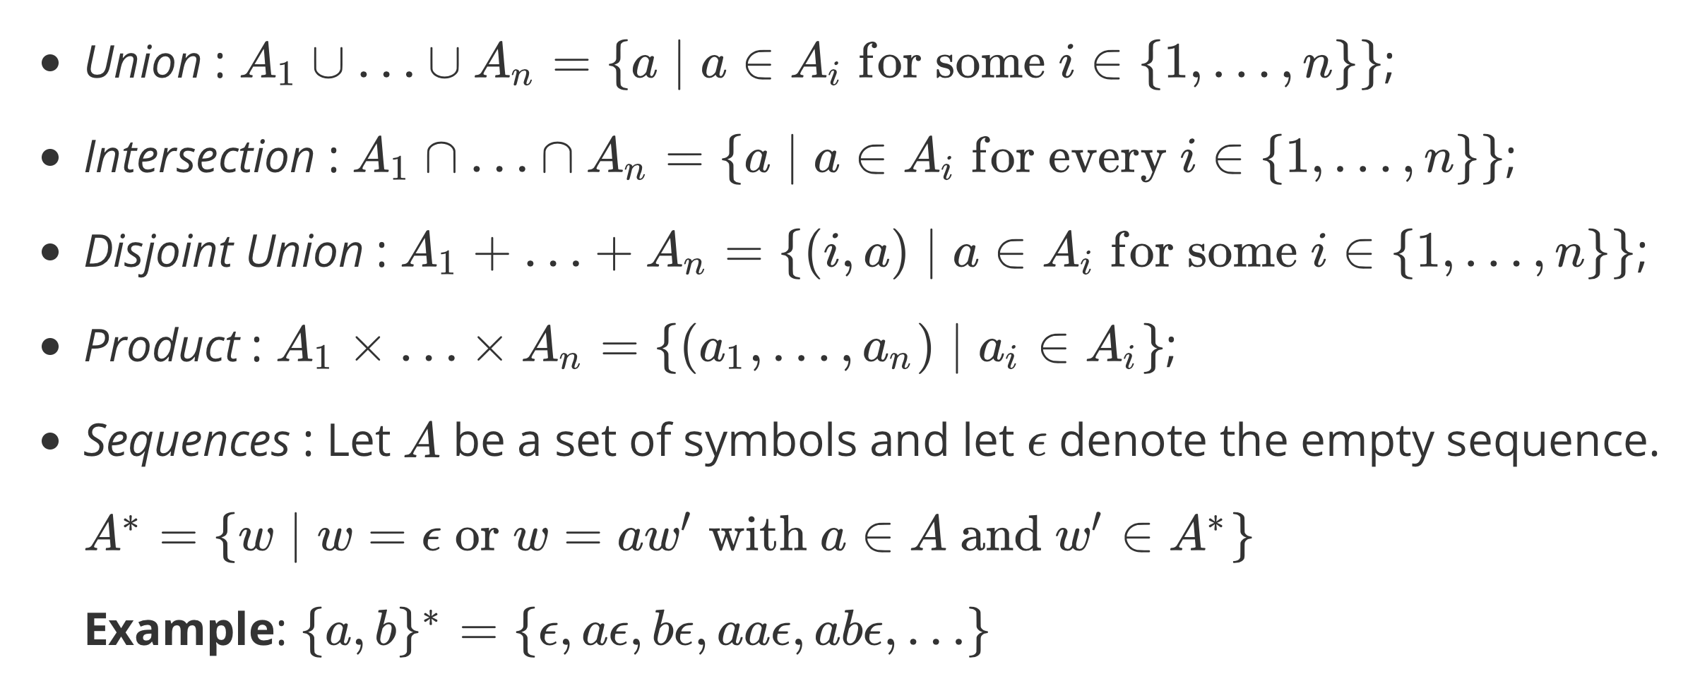
Building Sets

Slide 18
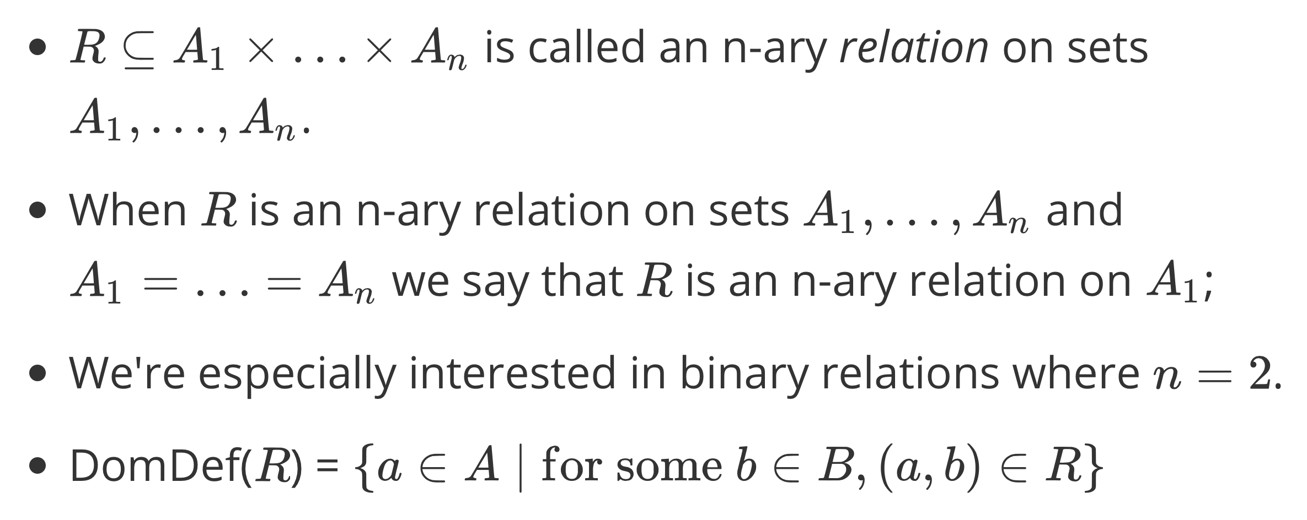
Relations

Slide 19
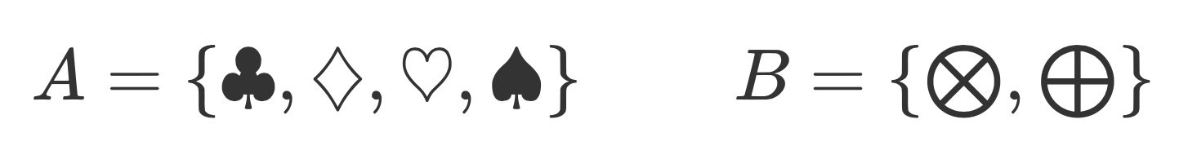
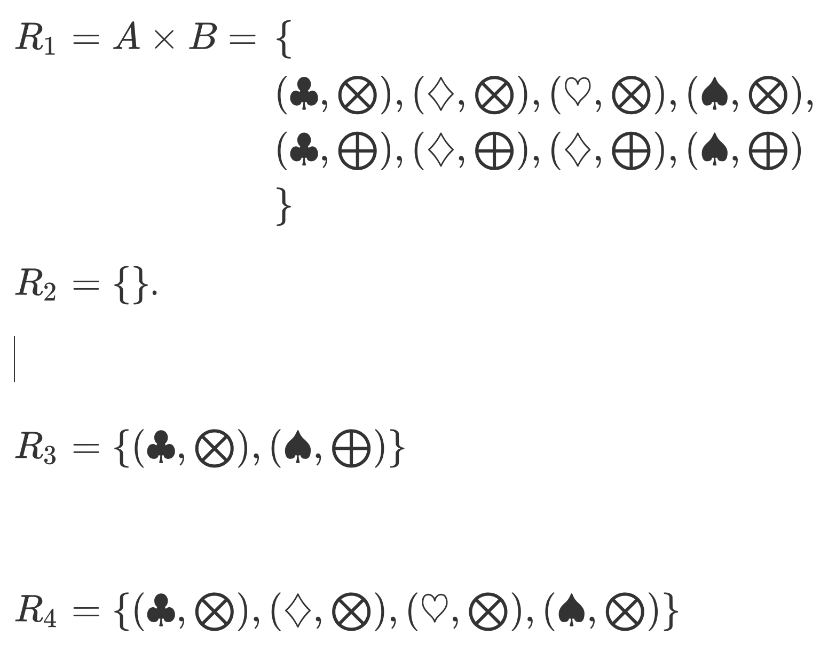

Slide 20
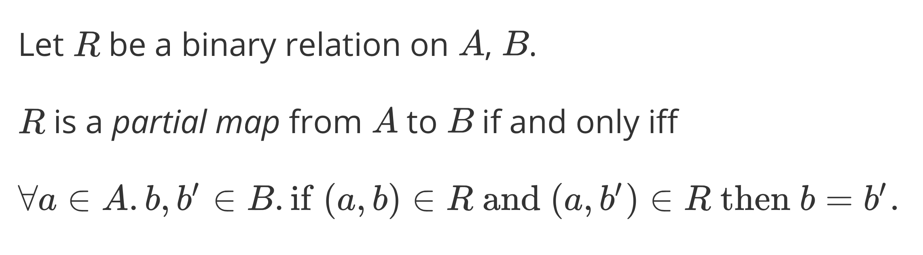
Partial Maps (aka Partial Functions)

Slide 21
Partial maps from A to B?

Slide 22
Only R₂, R₃ and R₄ are partial maps from A to B.

Slide 23
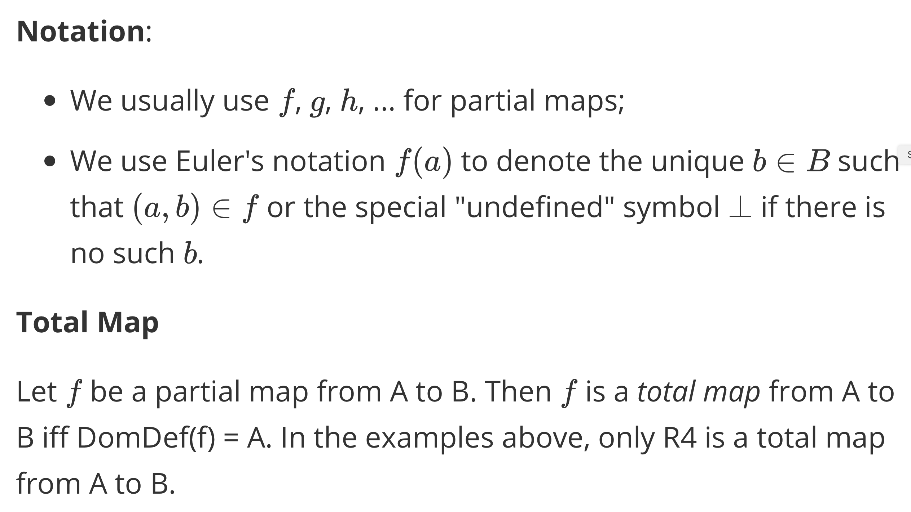

Slide 24
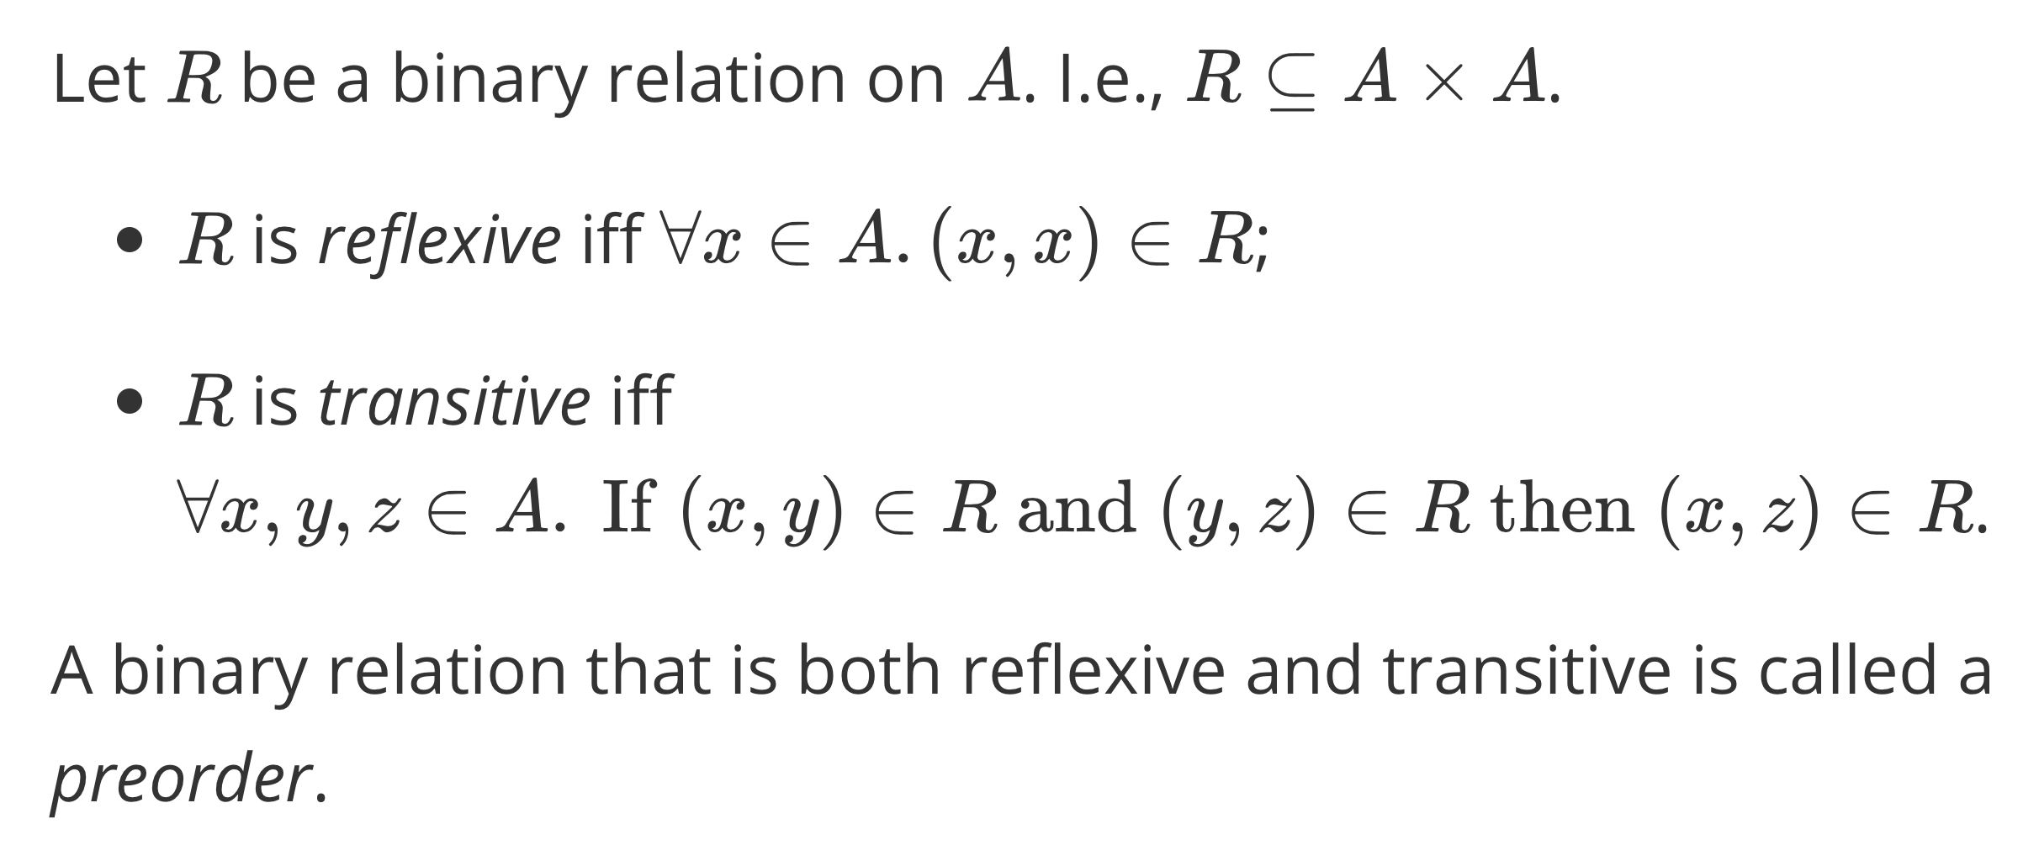
Preorders

Slide 25
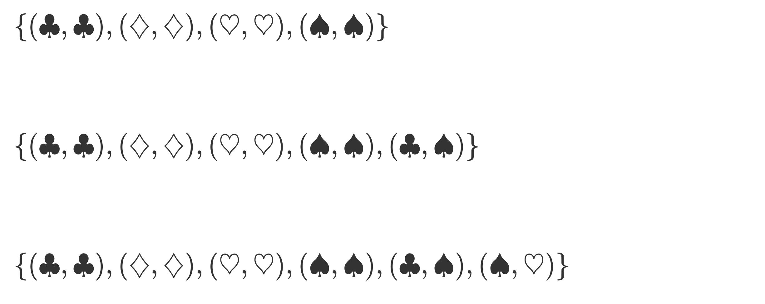
Preorders

Slide 26
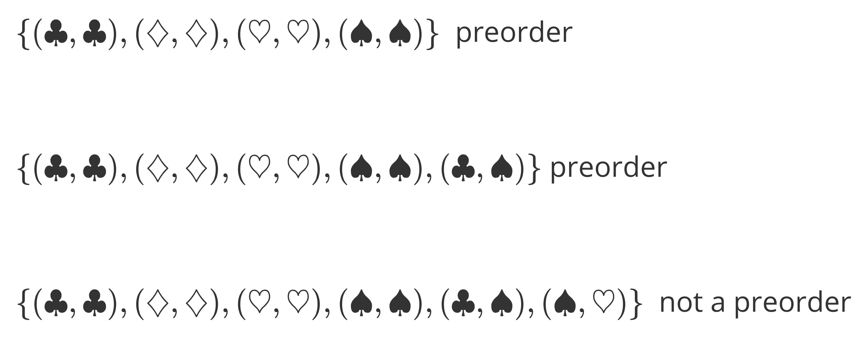
Preorders

Slide 27
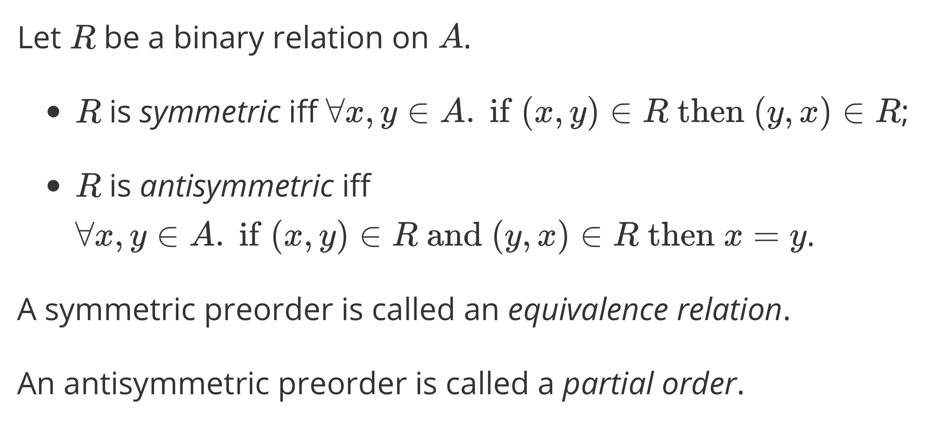
Equivalence Relations & Partial Orders

Slide 28
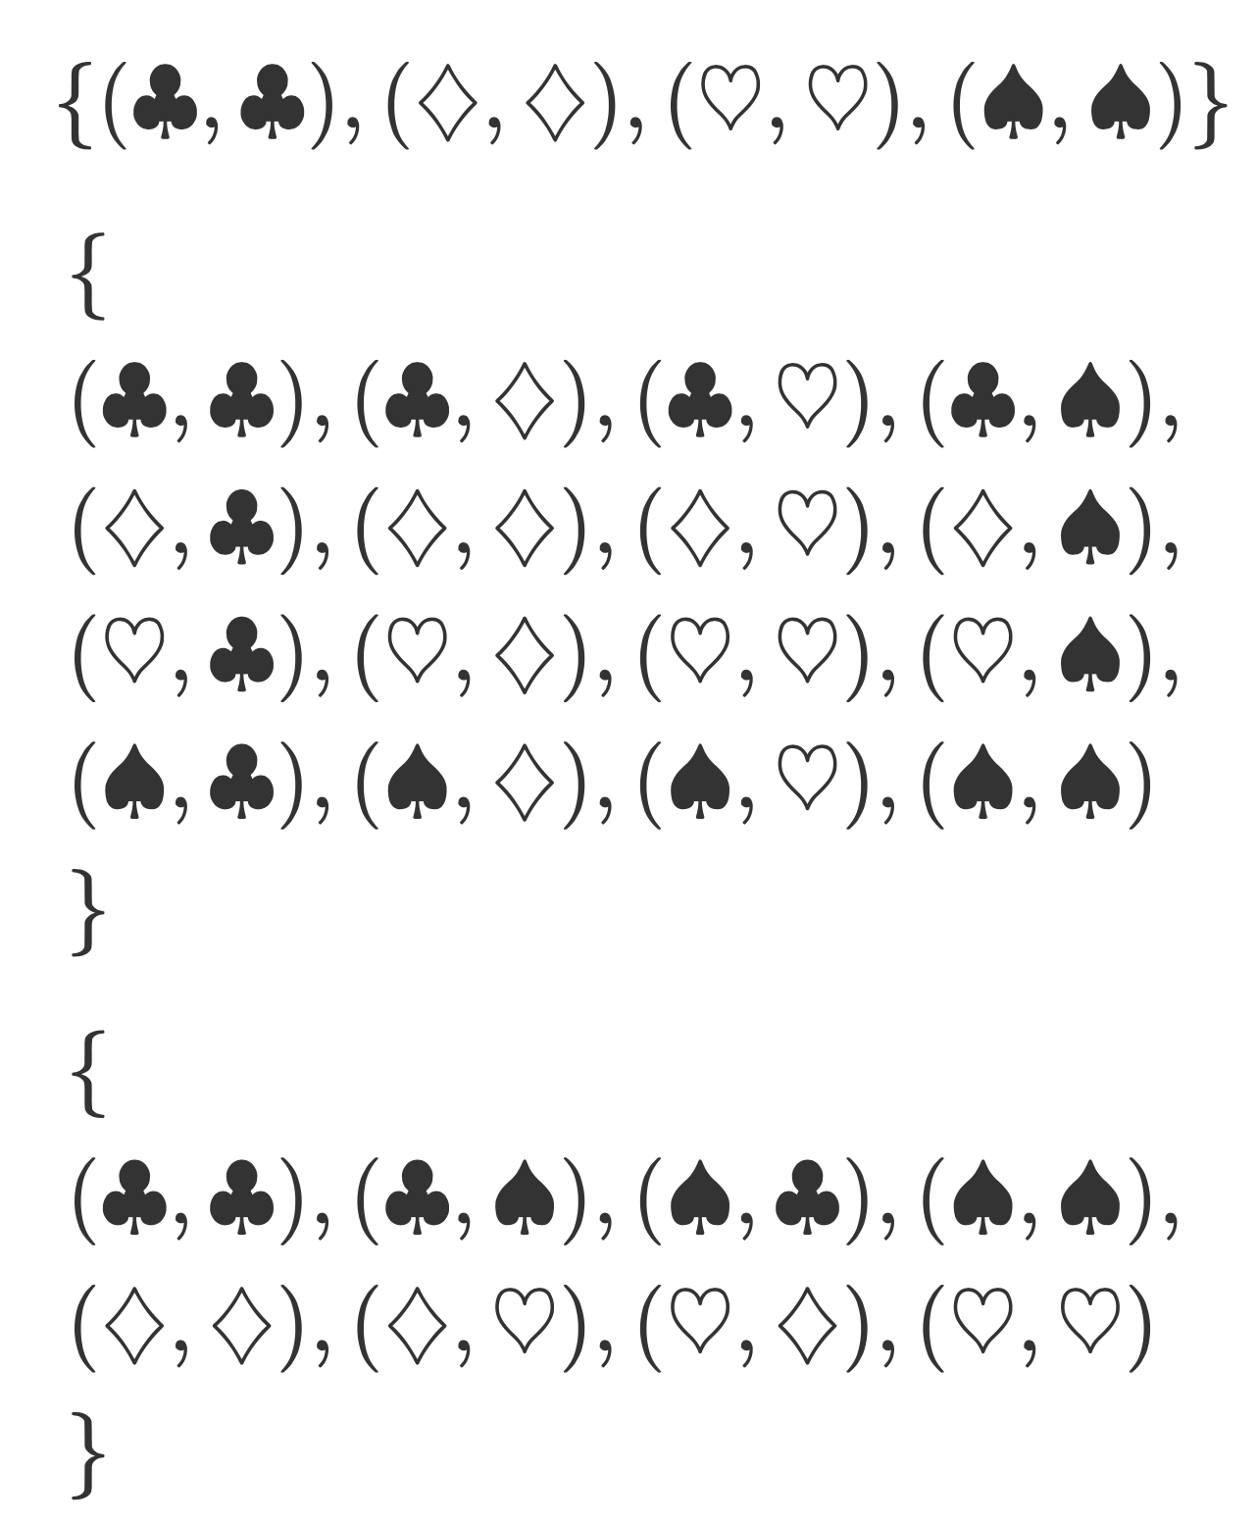





Slide 29
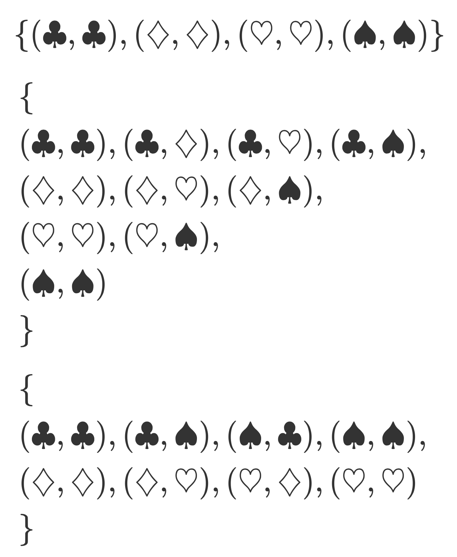
Not a partial order.

Slide 30
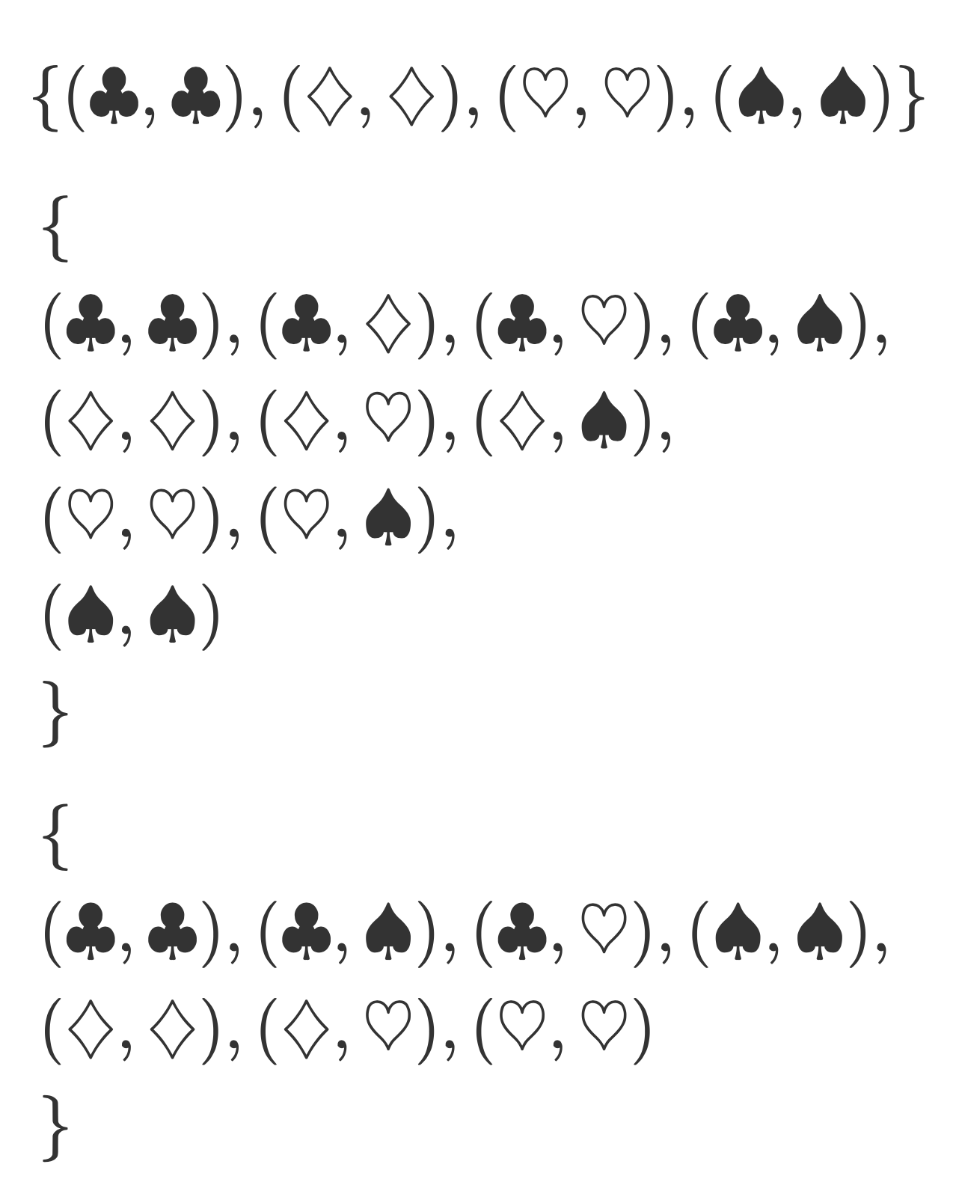

Slide 31
Total Order
Diamond isn’t comparable to either spade or club.
Good to go.

Slide 32
Java
equals – should define an equivalence relation, for items x and y of the same type.
If x isn’t null, y can’t be null;
x.equals(x)
If x.equals(y) then y.equals(x)
If x.equals(y) and y.equals(z) then x.equals(z).

Slide 33
Java
equals must be in synch with hashCode: any two items x and y such that x.equals(y) is true, it must be the case that
NB: it isn’t the case that if x.equals(y) is false, then
x.hashCode() == y.hashCode()
x.hashCode() =/= y.hashCode()

Slide 34
Java
compareTo – should define a total order;
compareTo should be consistent with equals: for items x and y of the same type, it should be the case that:
x.compareTo(y) == 0 if and only if x.equals(y)

